Slide 1
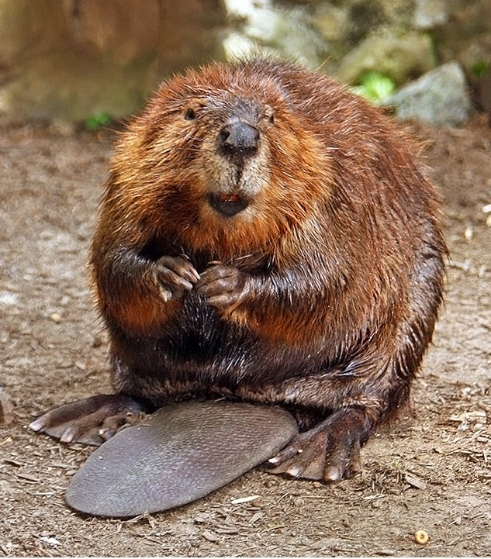


Test Your Knowledge of the American Beaver
Click here to start

Slide 2
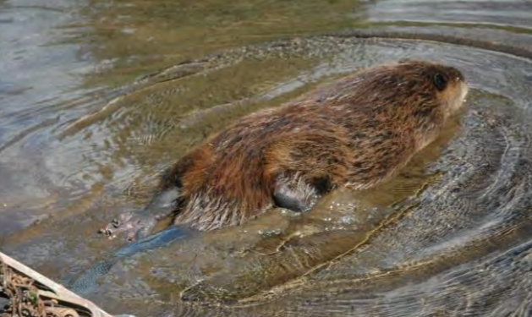
Which animal group do beavers belong to?
Weasels
Fish
Amphibians
Mammals
Felines
Reptiles
Click here for the answer

Slide 3
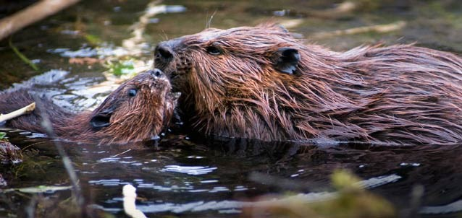
Beavers are mammals, like most mammals they:
Have fur
Breathe with lungs
Give birth to live young
Feed their babies milk
Are warm-blooded
Are vertebrates
Click here for next question
The Beaver is the official New York State Mammal

Slide 4
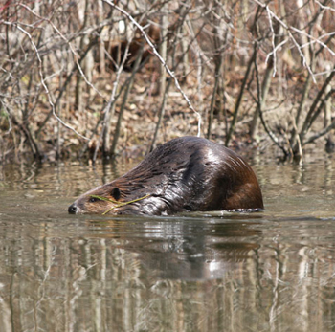
Animals are divided into groups based on the food they eat.
Carnivores (eat only meat)
Herbivores (eat only plants)
Omnivores (eat meat and plants)
Which group do beavers belong to?
Click here for the answer

Slide 5
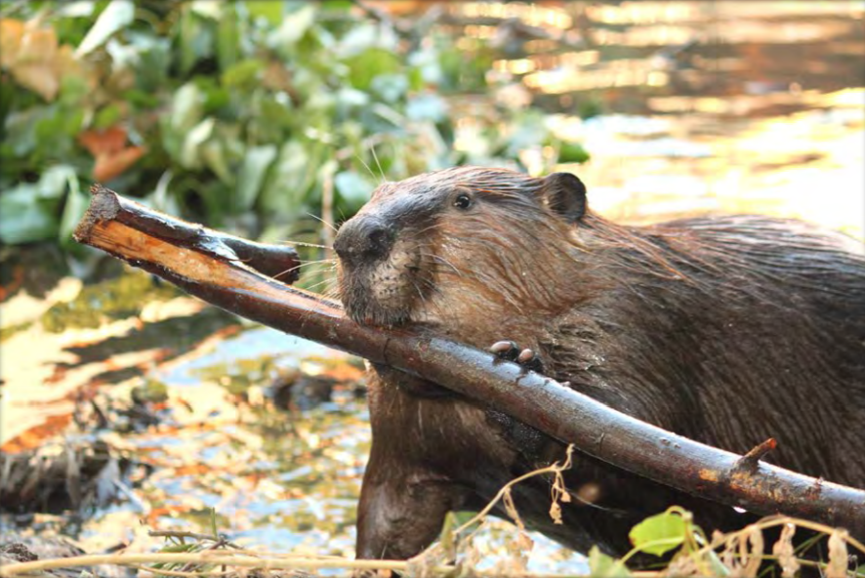
Beavers are herbivores
They like to eat:
bark, twigs, buds, leaves, grasses, berries, lily pads, and cattails
Click here for next question

Slide 6
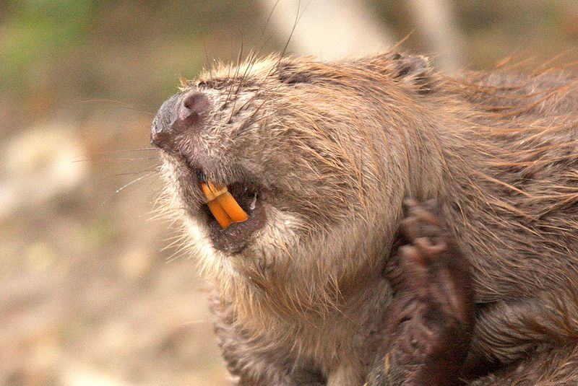
The beaver is the largest rodent in North America
All rodents have large; orange front teeth that are known as:
Canines
Wisdom
Incisors
Molars
Click here for the answer

Slide 7
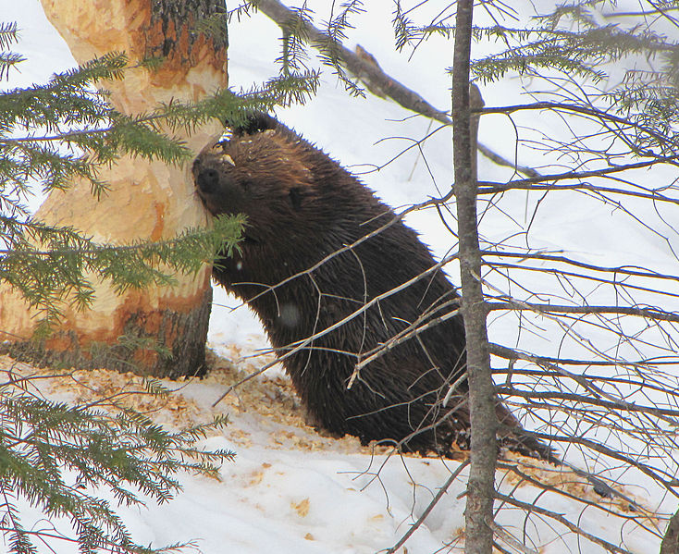
Rodents’ front teeth are called incisors.
Beavers must gnaw continuously to keep their teeth from growing too long.
Beavers use their incisors to chew through large tree trunks.
Click here for next question

Slide 8
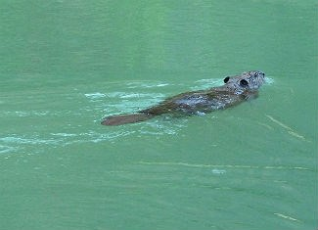
Beavers are perfectly adapted for life in the water.
Which parts of the beaver help them live in the water?
Click here for the answer

Slide 9
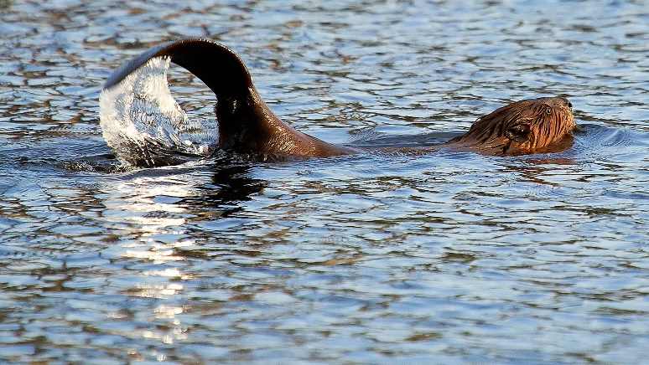
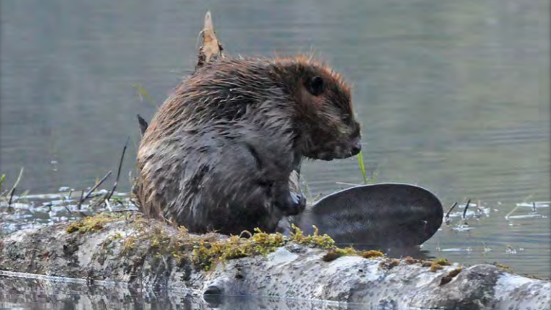
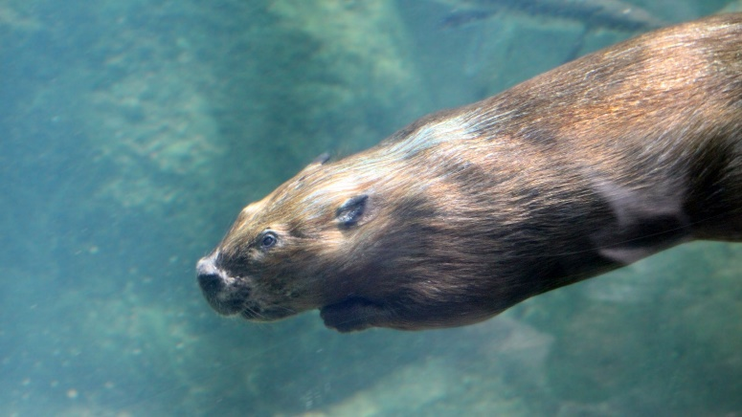
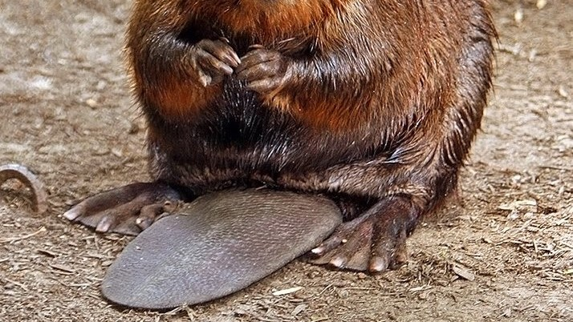
Here are a few aquatic adaptations of the beaver
Paddle shaped tail for swimming and protection
Oily, waterproof fur keeps
them dry and warm
Click here for next question
Clear eyelids for seeing underwater
Webbed back feet for swimming

Slide 10
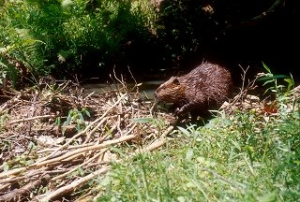
Beavers are nature’s engineers
Which of the following do beavers not build?
Lodges
Canals
Tree nests
Dams
Burrows
Click here for answer

Slide 11
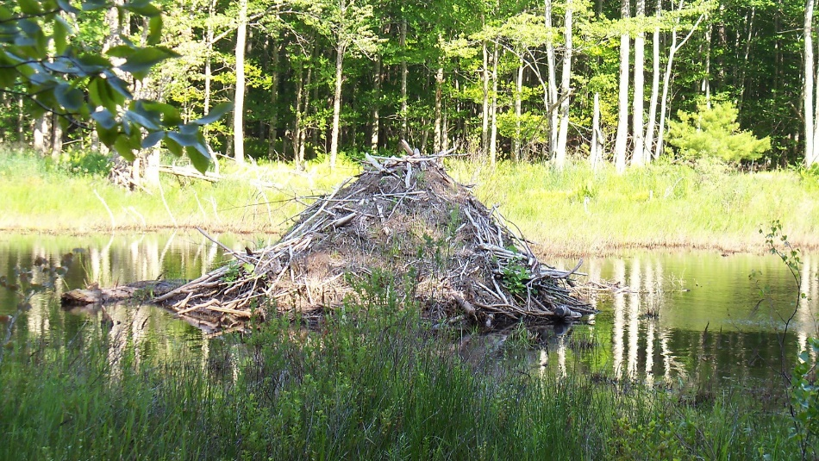
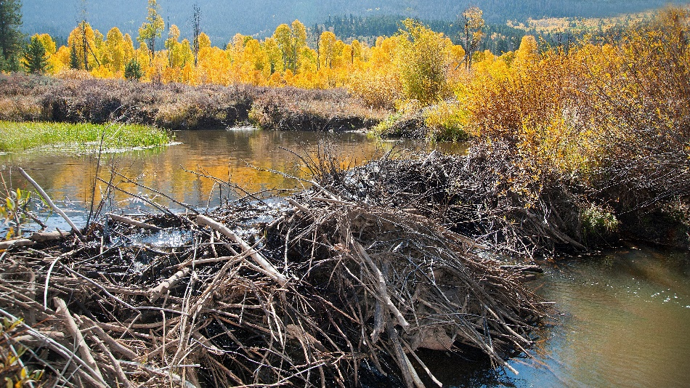
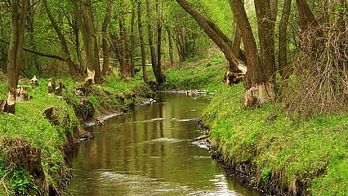
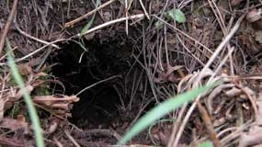
Beavers do not make tree nests, but they do make:
Lodges
Dams
Click here for next slide
Canals
Burrows

Slide 12
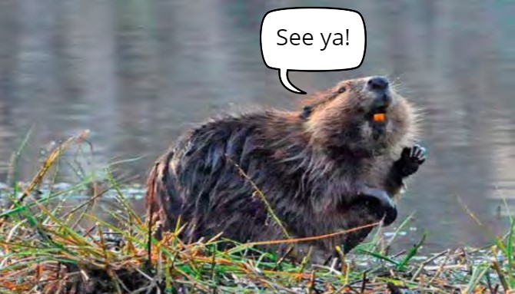

The American Beaver
Thanks for taking our quiz!
For more info about the American Beaver, check out our YouTube video

