Slide 1
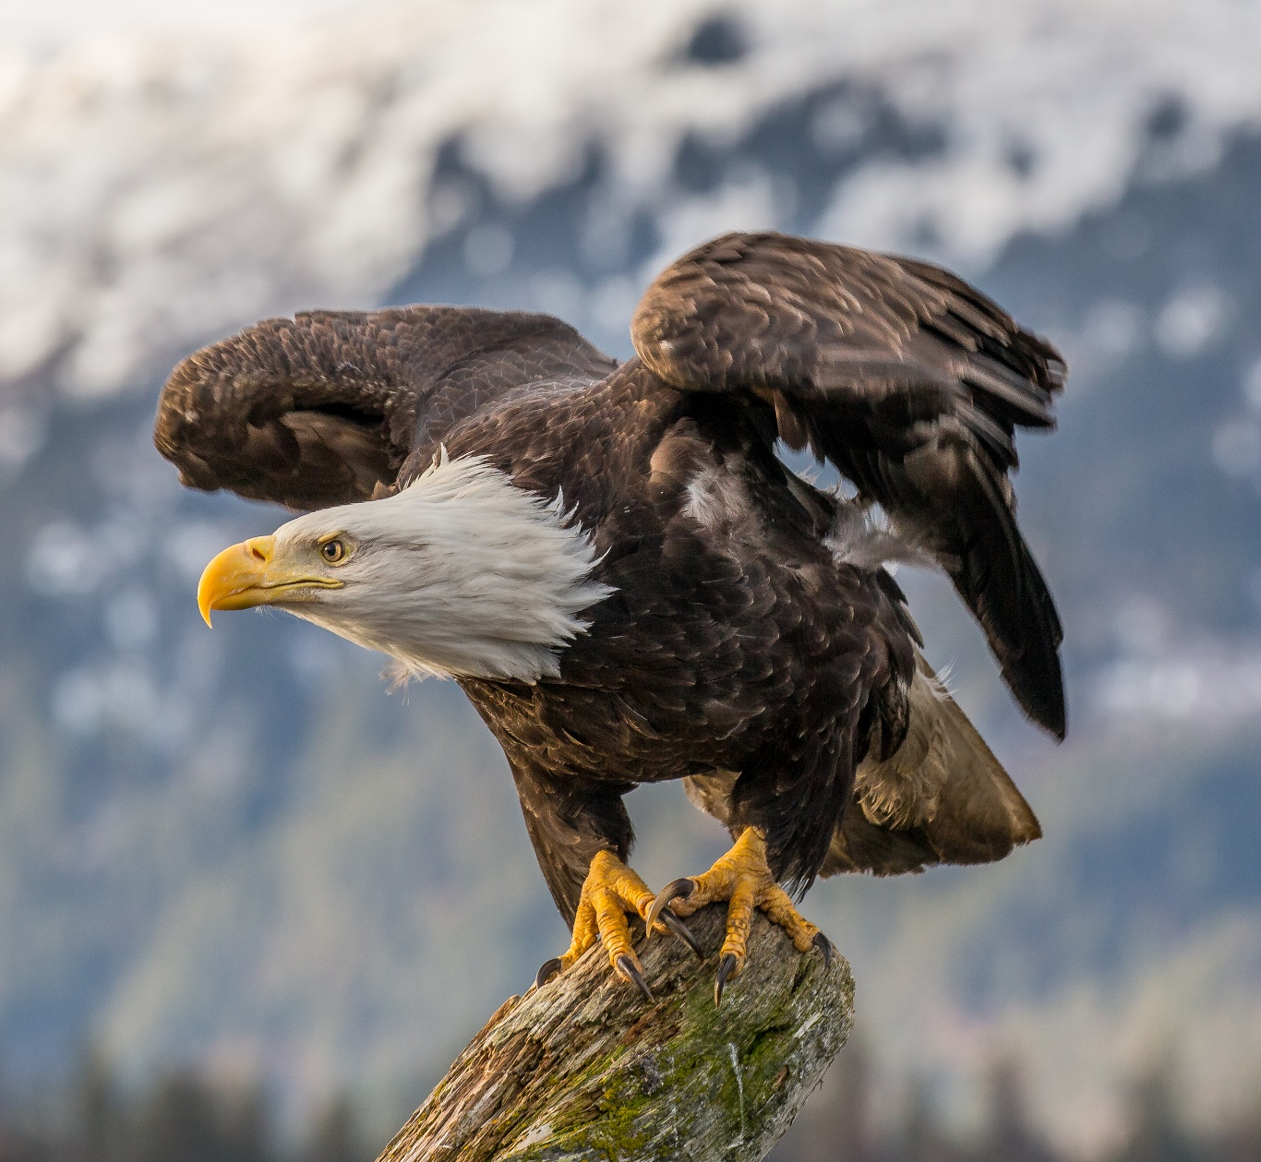


Test Your Knowledge of the Bald Eagle
Click here to start

Slide 2
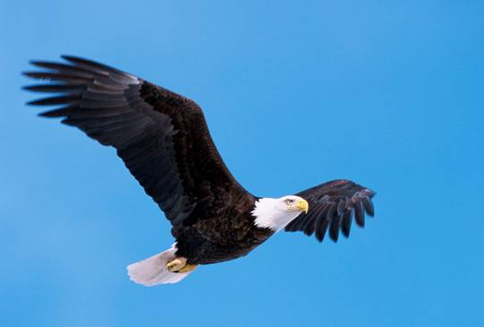
Which group of birds do Bald Eagles belong to?
Songbirds
Game Birds
Aquatic
Birds
Birds of
Prey
Shore
Birds
Tropical Birds
Click here for the answer

Slide 3
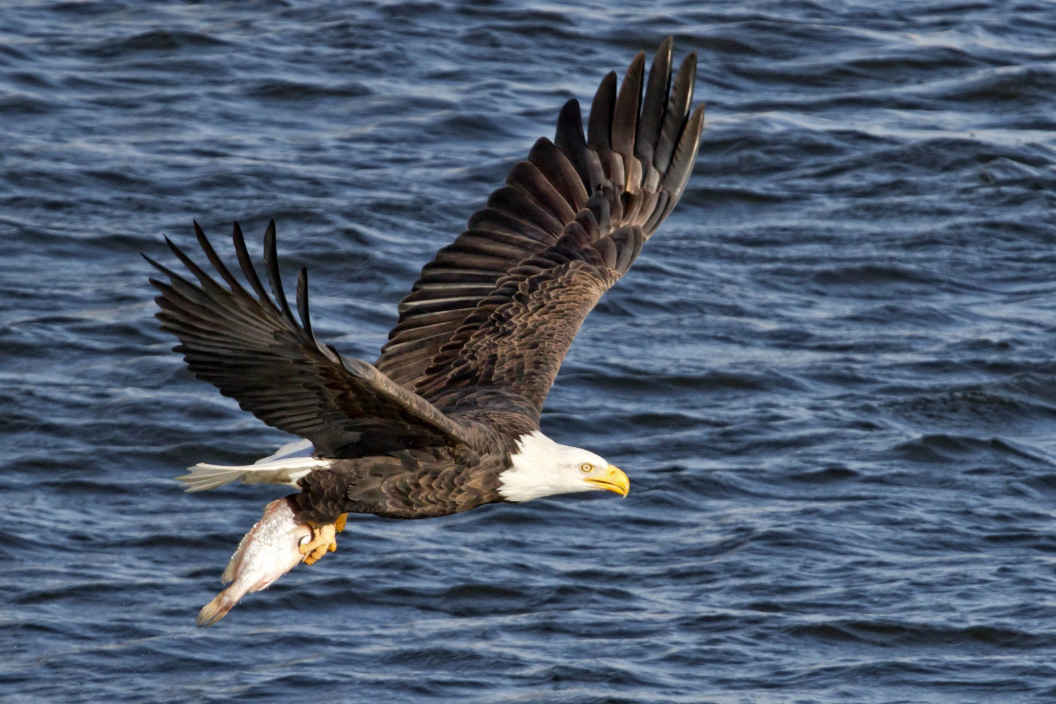
Bald Eagles are birds of prey, they have:
Powerful wings
Pointed beaks
Sharp talons on their feet
Excellent vision
Click here for next question
The Bald Eagle is the official symbol of the USA

Slide 4
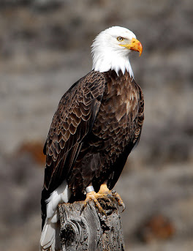
Animals are divided into groups based on the food they eat.
Carnivores (eat only meat)
Herbivores (eat only plants)
Omnivores (eat meat and plants)
Which group do bald eagles belong to?
Click here for the answer

Slide 5
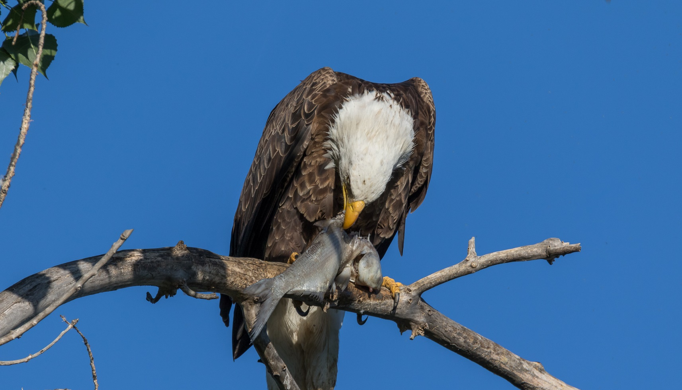
Bald Eagles are carnivores.
They like to eat:
Fish, birds, small mammals, and carrion (the remains of dead animals).
Click here for next question

Slide 6
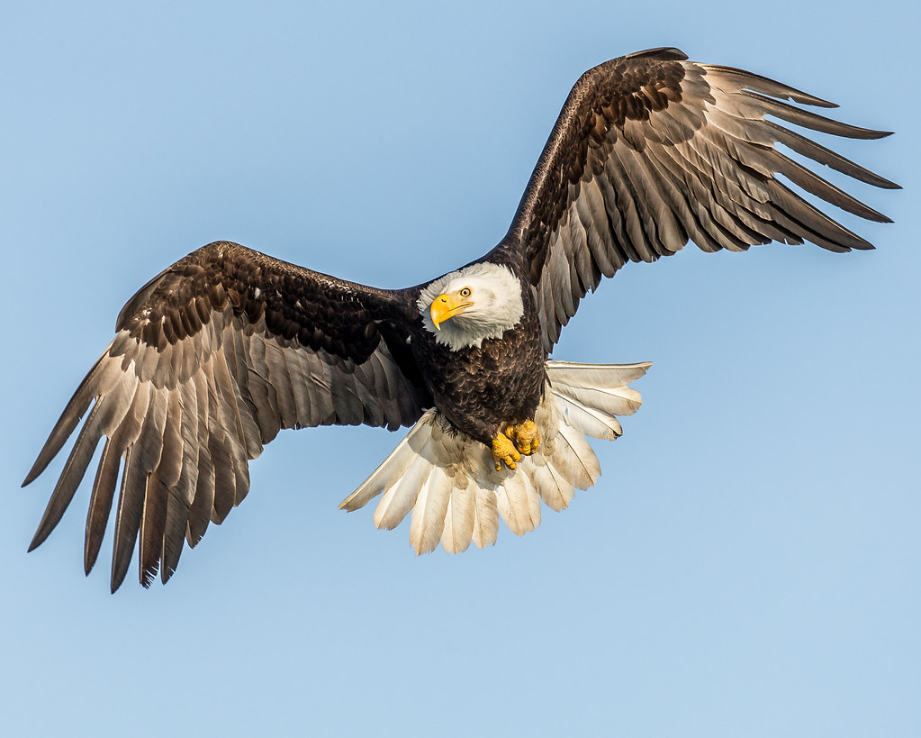
What is the preferred habitat of the Bald Eagle?
Tall mountains
Dense woodlands
Cold climates
Near water
Open fields
Click here for the answer

Slide 7
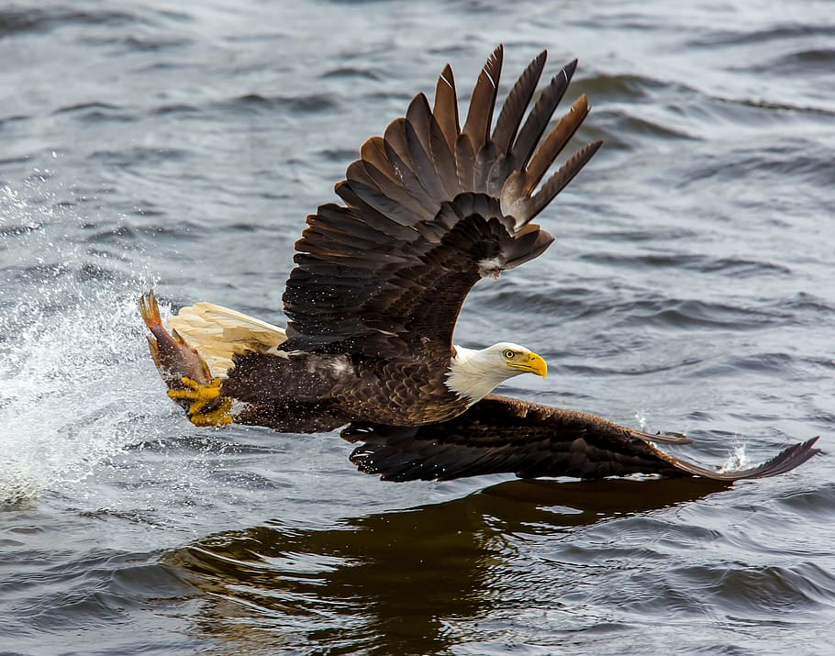
Bald Eagles most commonly live near water
Large rivers, lakes and seacoasts provide bald eagles with the opportunity to catch fish which make up about 90% of their diet.
Click here for next question

Slide 8
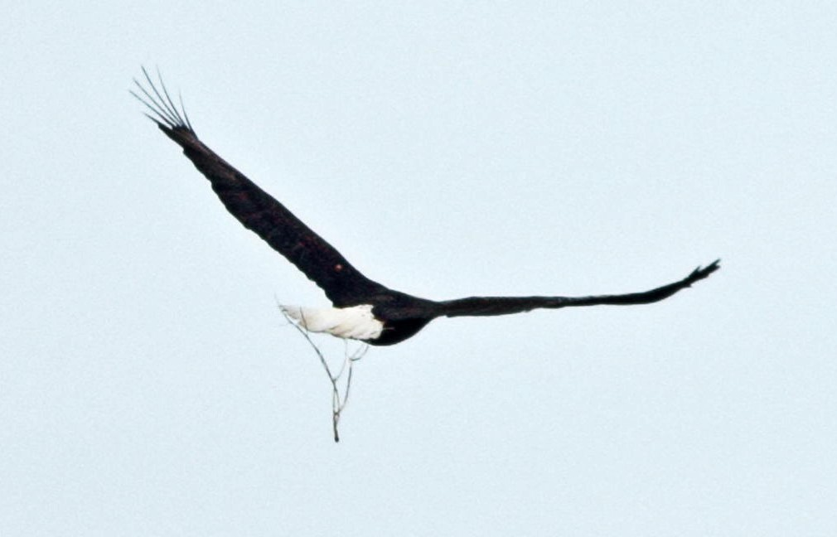
Where do Bald Eagles typically make their nests?
On the ground
Treetops
Rock outcrops
Riverbanks
Click here for answer

Slide 9
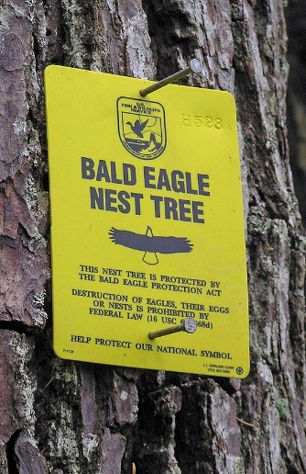
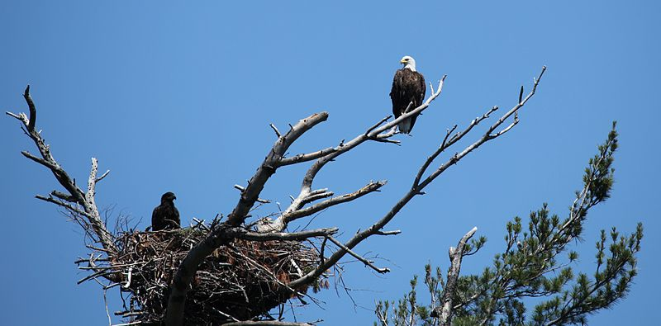
Bald Eagles make tree nests
Bald Eagles usually build large nests in tall treetops. Made from large sticks, these nests can be 4 to 5 feet wide and 2 to 4 feet deep. They will use the same nest year after year.
Click here for next question

Slide 10
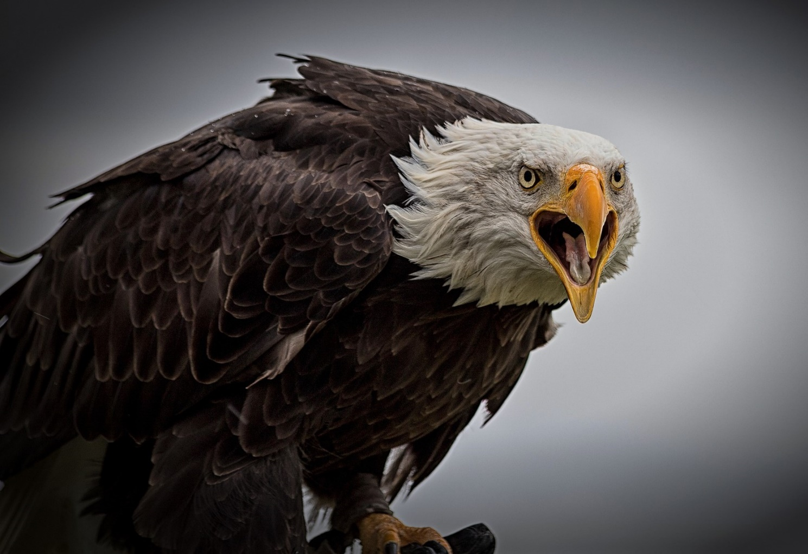
As a federally protected bird,
Bald Eagles are now considered?
Of least concern
Endangered
Threatened
Vulnerable
Extinct
Click here for the answer

Slide 11
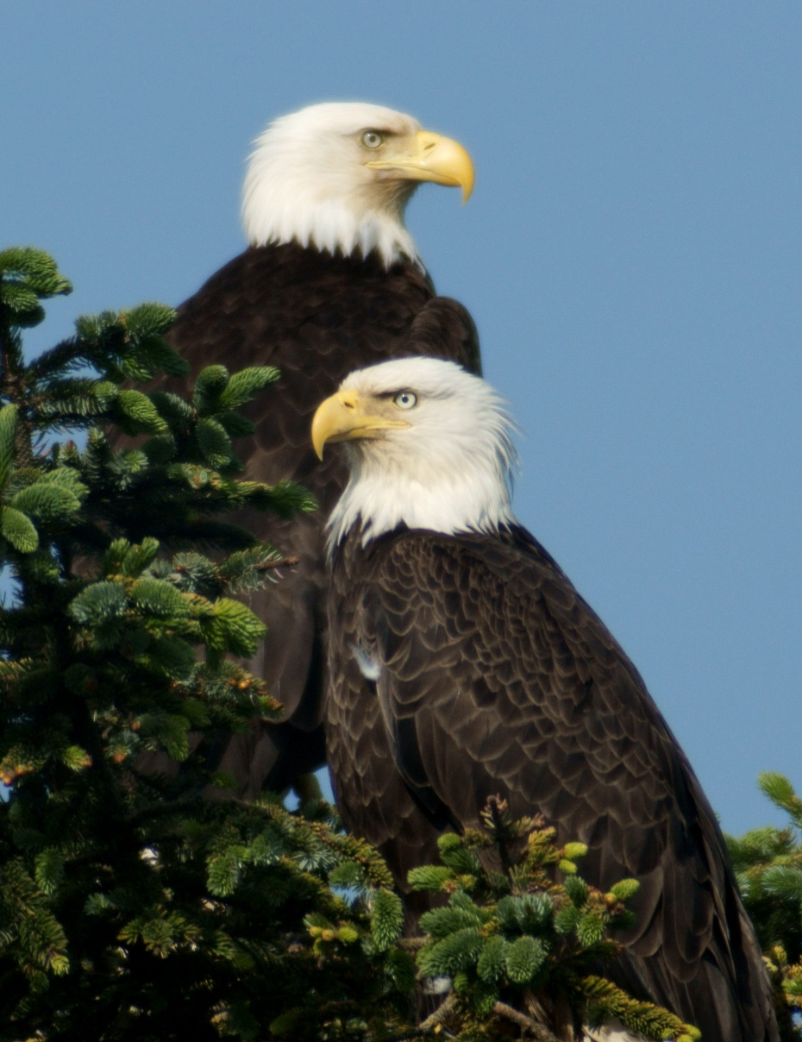
While still protected by Federal Law, Bald Eagles are now considered to be a species of least concern
By the 1960’s the bald eagle was close to vanishing from the continental United States. Hunting, habitat destruction and contamination from the use of the chemical pesticide known as DDT pushed the species towards extinction.
In 1972, it was one of the first species to receive protection under the Endangered Species Act. Since then, the bald eagle population has recovered to the point where it is no longer, endangered, vulnerable or threatened.
Click here for next slide

Slide 12
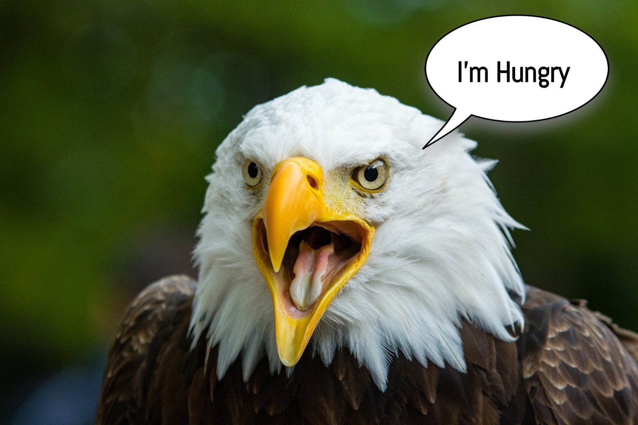

The Bald Eagle
Thanks for taking our quiz!
For more info about the Bald Eagle, check out this YouTube video

